Slide 1
Data analysis and visualisation in R for Biologists Session 2 Data exploration in depth
Irina & Rao
Hilary 2024

Slide 2
R for biologists
Data Visualisation
Assignment from week 1
Intro to ggplot2
Base R plotting vs ggplot2
ggplot2 syntax (demo)
Intro to factors
Reshaping data.frames (demo)
Dot/box/bar plots (demo with Covid vaccine data)
Practical (breakout room)
OWID Covid data

Slide 3
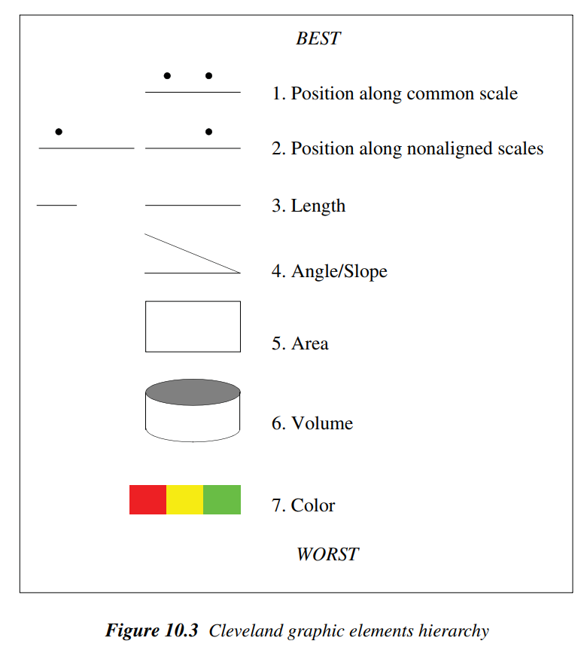
How to choose the graph type
Human perception is not uniformly good at distinguishing different physical aspects – e.g. length is better than volume
Factors to help decide on viz:
Information – detail or summary?
Number of dimensions
Comparisons
Continuous vs categorical data
Scale – e.g. linear or log?
Shape and size
Colours – distinct? Colour-blind friendly?
Legends and labels
Subplots
From Data to Viz – A handy tool to help you decide
The Grammar of Graphics, 2005

Slide 4
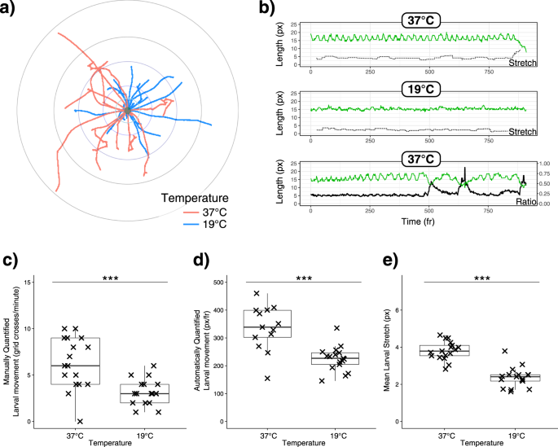
How to choose the graph type
Using the same data but making different points
Rao et al., Sci Rep, 2019

Slide 5
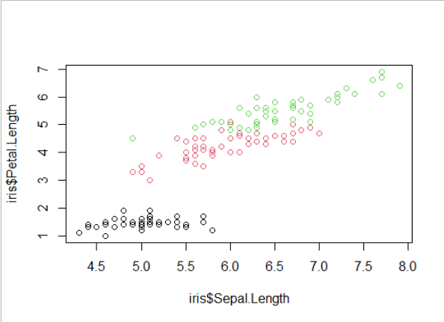
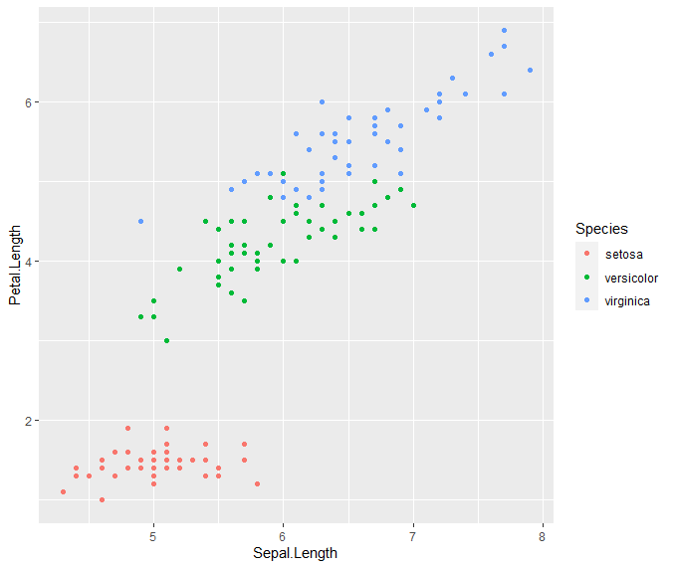
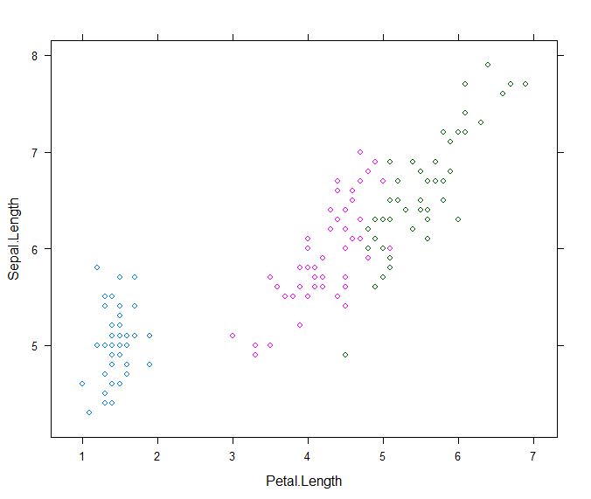
Visualising data in R
Base R plotting (e.g. plot() function)
plot(x = iris$Sepal.Length, y = iris$Petal.Length, col = iris$Species)
ggplot2 package
ggplot(iris, aes(x = Sepal.Length, y = Petal.Length, colour = Species)) + geom_point()
Lattice package
xyplot(Sepal.Length ~ Petal.Length, data = iris, groups = Species)
Grid package
Low level plotting (both ggplot2 and lattice built on grid graphics)

Slide 6
Graphics devices in R
The plotting window in Rstudio
Needs to be saved manually
Size of the figure can be adjusted manually
Can be copied to clipboard from RStudio
For quick exploratory visualisation
A file (svg, png, pdf, tiff, jpeg, bmp)
Saved to file from code
Size of the figure can be specified in the code
For creating reproducible figures
png(), pdf(), svg(), ggsave() are functions to save plots
Start or close graphical devices with dev.new() or dev.off() respectively
Tip: If your plot is not showing up on the window or file that you are expecting it to, you are probably drawing on the wrong device. dev.off() may solve this issue.

Slide 7
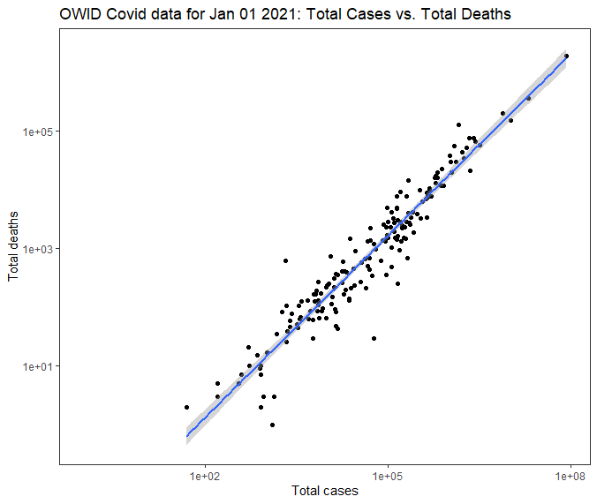

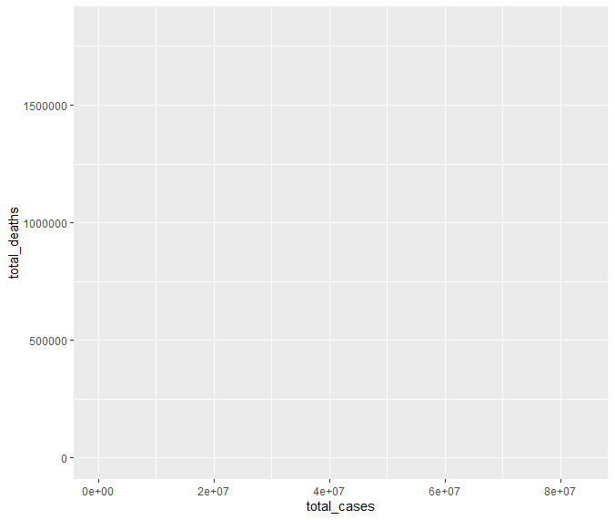
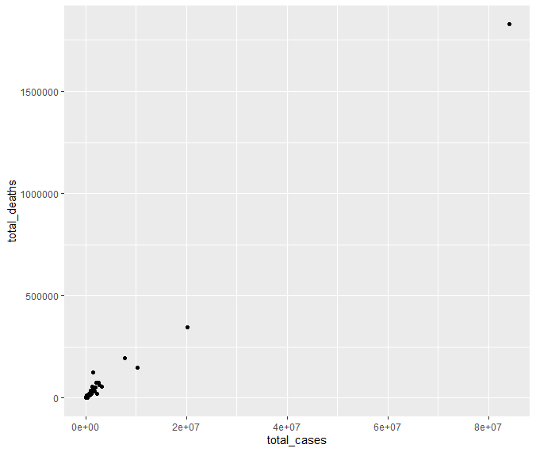
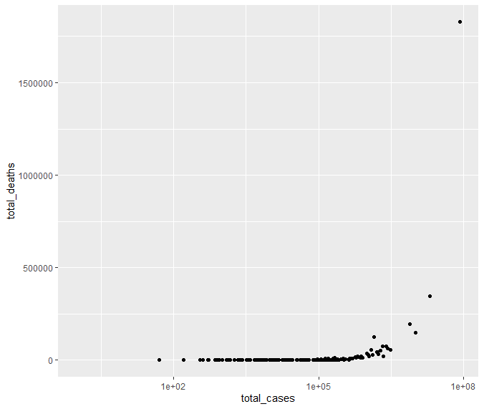
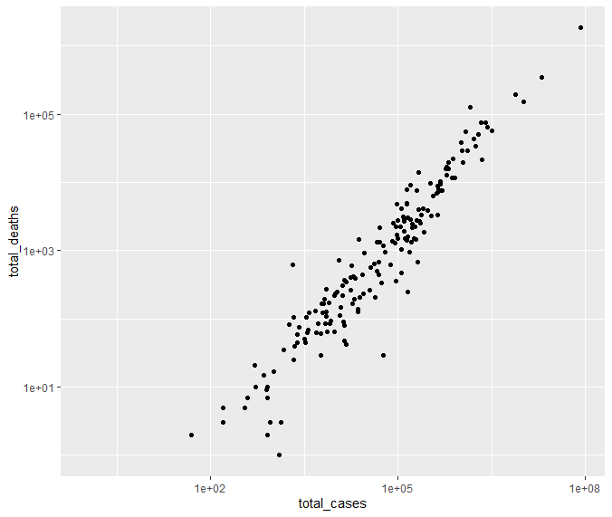
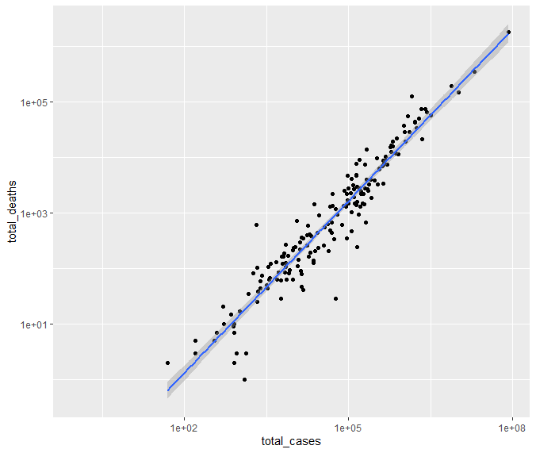
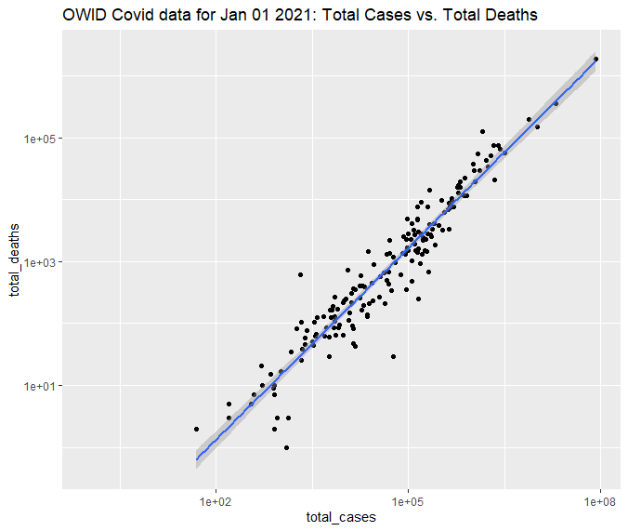


Building a graph step-by-step with ggplot2
ggplot(owid_covid_newyear, aes(x = total_cases, y = total_deaths)) +
geom_point() +
scale_x_log10() +
scale_y_log10() +
geom_smooth(method = "lm") +
ggtitle("OWID Covid data for Jan 01 2021: Total Cases vs. Total Deaths") +
xlab("Total cases") +
ylab("Total deaths") +
theme_bw() +
theme(panel.grid = element_blank())

Slide 8
ggplot2 syntax
Global mapping – applies to the entire plot
ggplot(data, mapping) +
geom_point(mapping, stat, position, colour, fill, shape, size, alpha) +
coord_cartesian() +
scale_colour_discrete() +
facet_wrap() +
theme_bw() +
ggtitle() +
labs()
Geom-specific
Where,
mapping = aes(x, y, colour, fill, shape, size, alpha)
Note: Colour, shape, alpha, etc. can be passed
to the mapping argument - changes attributes based on some variable in the dataset itself (e.g. colour = location, or shape = hdi_class)
directly as specific arguments in the geom function - changes the attributes to fixed values that are provided separately from the data (e.g. colour = “red” or size = 10)

Slide 9

Let’s explore practically

Slide 10
How to plot your data?
The most common plots in publications:
box plots/violin plots, bar plots, dot plots, histograms/density plots, line graphs, networks, heatmaps, PCA, etc.
Hint: choose the appropriate representation based on the type of data you have.
Typical data types: numeric, categoric, maps, network, time series
+combinations of those
From Data to Viz – Decision tree to choose an appropriate chart type for your data

Slide 11
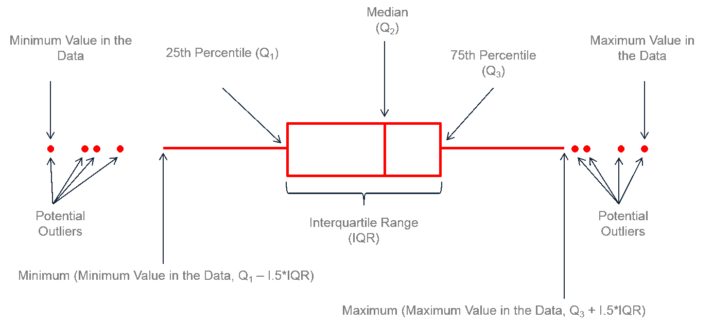
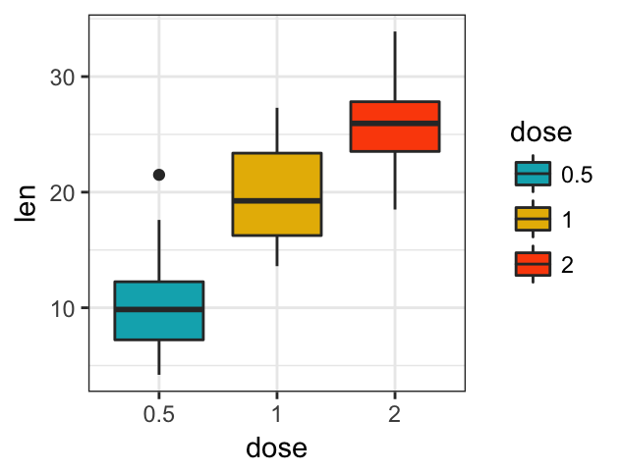
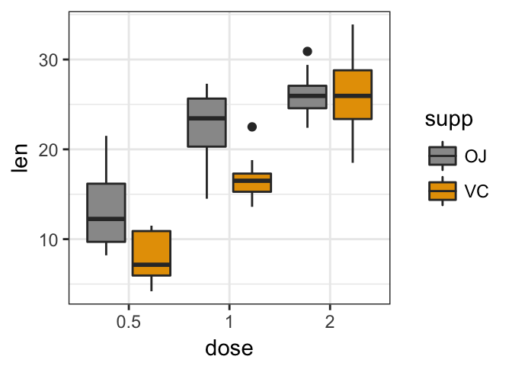
Plotting grouped data
Box-plots
geom_boxplot()

Slide 12
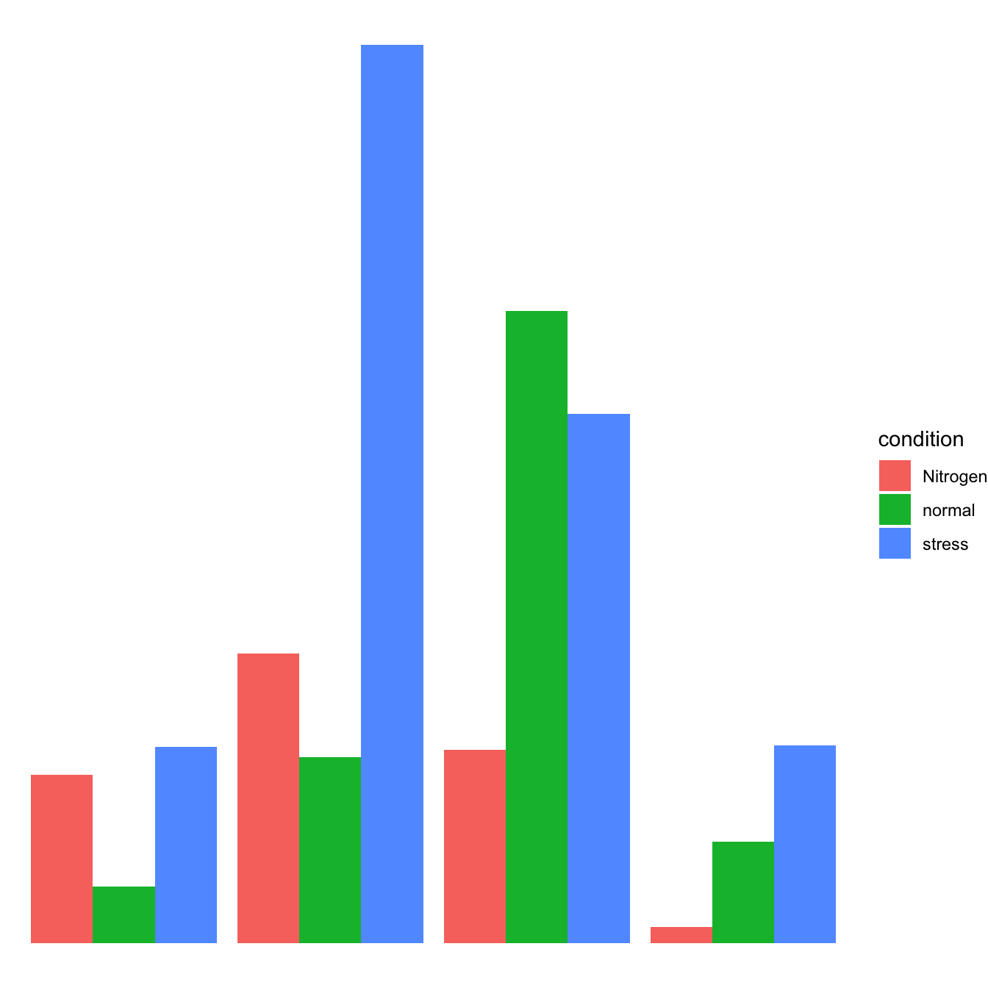
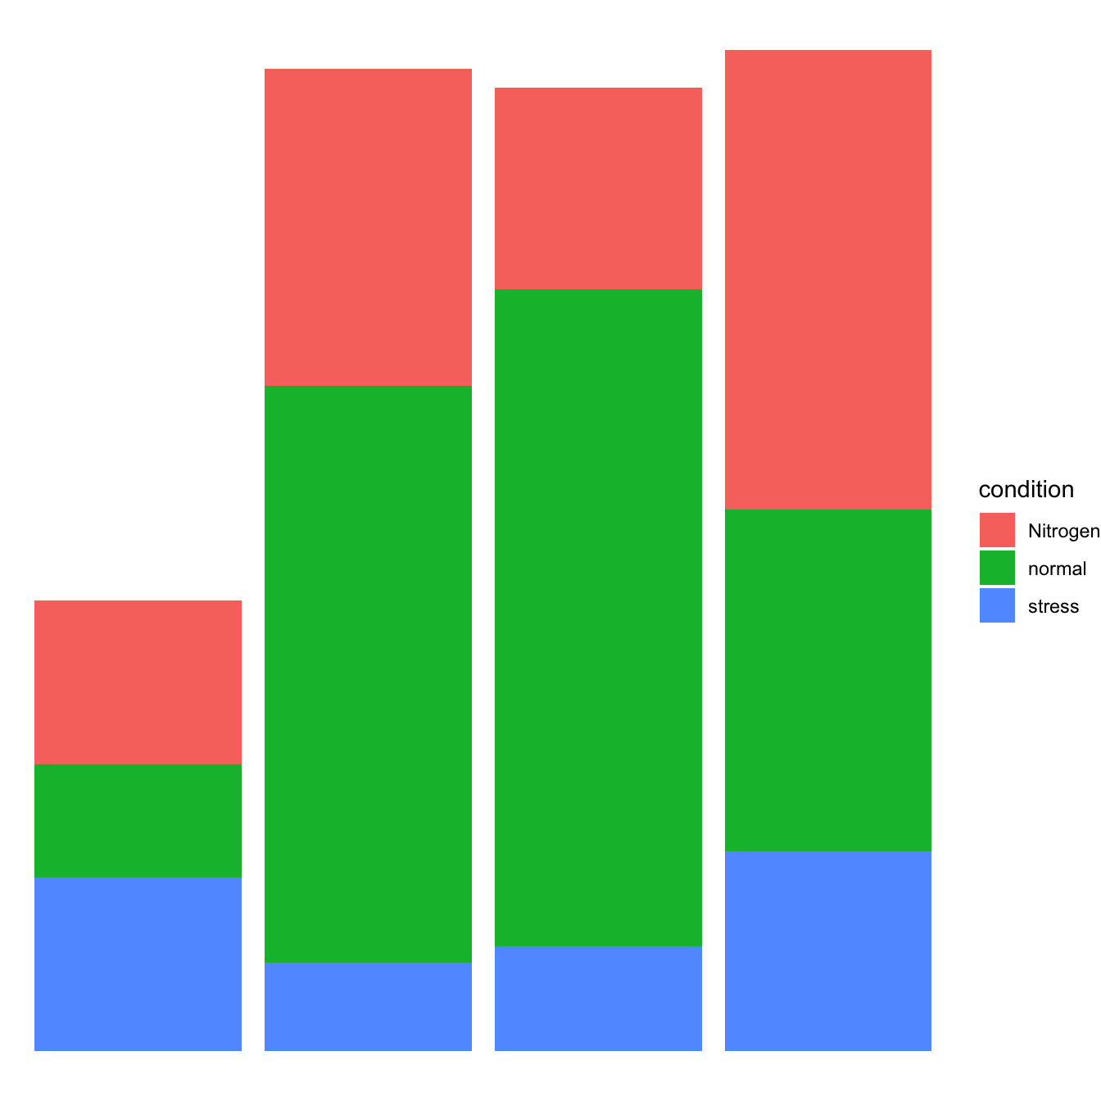
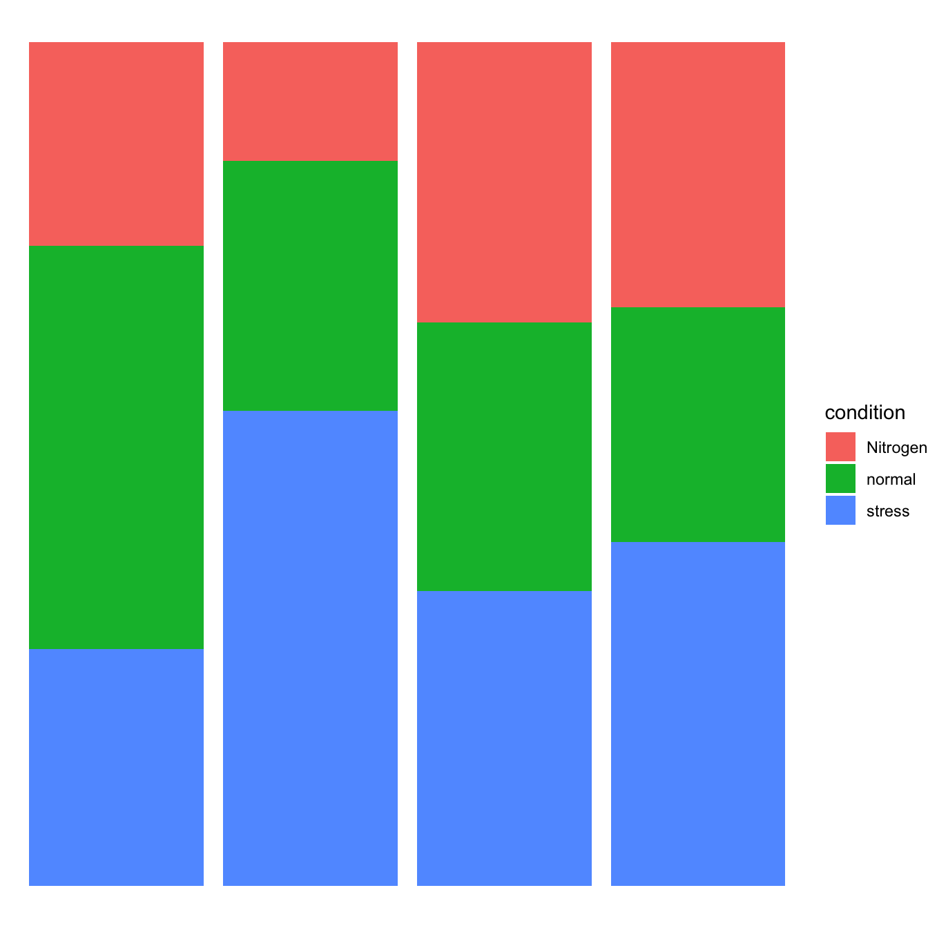
Plotting grouped data
Bar plots
geom_bar(position=...)
position="dodge"
position="stack"
position="fill"

Slide 13
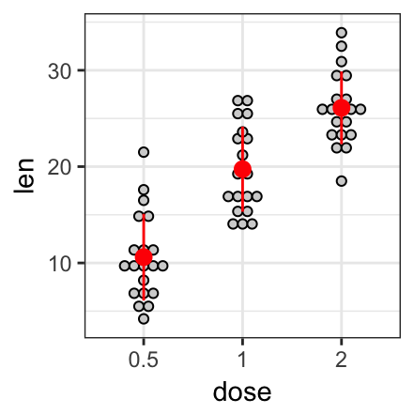
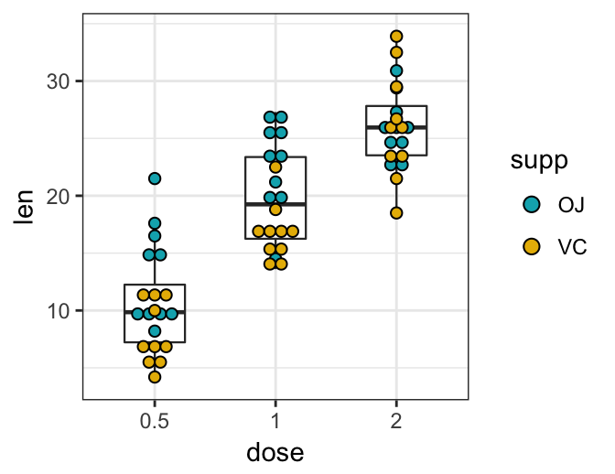
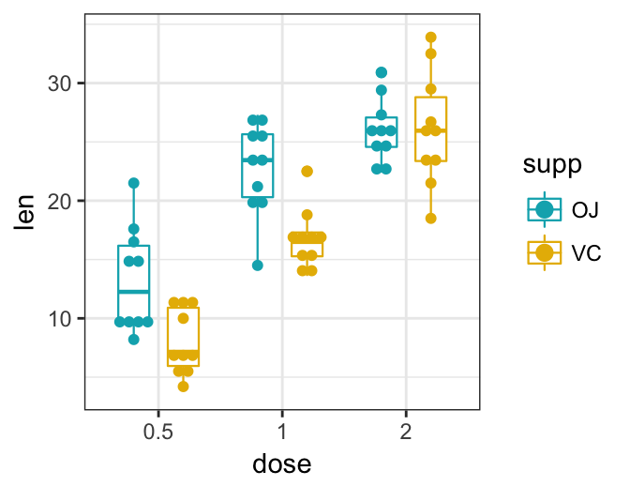
Plotting grouped data
Dot plots
geom_dotplot()
ggplot(…)+ geom_dotplot(…)
ggplot(…)+ geom_boxplot(…)+ geom_dotplot(…)
ggplot(…)+
geom_boxplot(position = "dodge")+
geom_dotplot(…)

Slide 14
Understanding factors
Factors are used to represent categorical data.
Factors don't have to be binary! You can have many categories.
When you import a table to R, your categorical columns are treated as characters ("Germany", "Belgium", "Germany", etc.) or numbers (1, 2): using safest option - stringsAsFactors = FALSE argument in read... functions.
You know where your categories are presented. Convert the relevant column into factor:
df1$col1 <- as.factor(df1$col1)
Factors have levels, you can check all the categories within the factor:
levels(df1$col1)
You need to have your categories as factors in order to analyse and to plot the data by group!

Slide 15
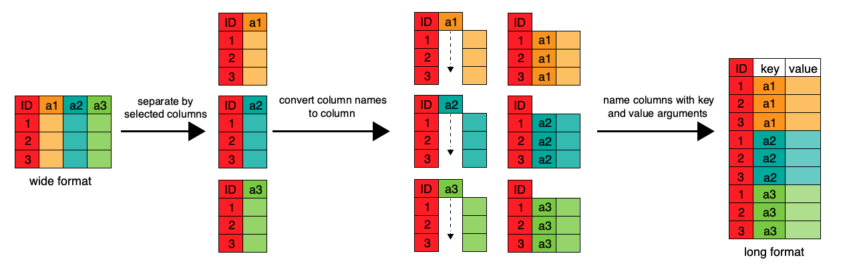
Wide vs. Long data format

Slide 16
Reshaping data with tidyr
gather(data, key = "key", value = "value", ..., na.rm = FALSE)
Wide-to-long format:
Gather columns into key-value pairs
spread(data, key, value)
Long-to-wide format:
Spread a key-value pair across multiple columns
tidyr is a part of Tidyverse

Slide 17
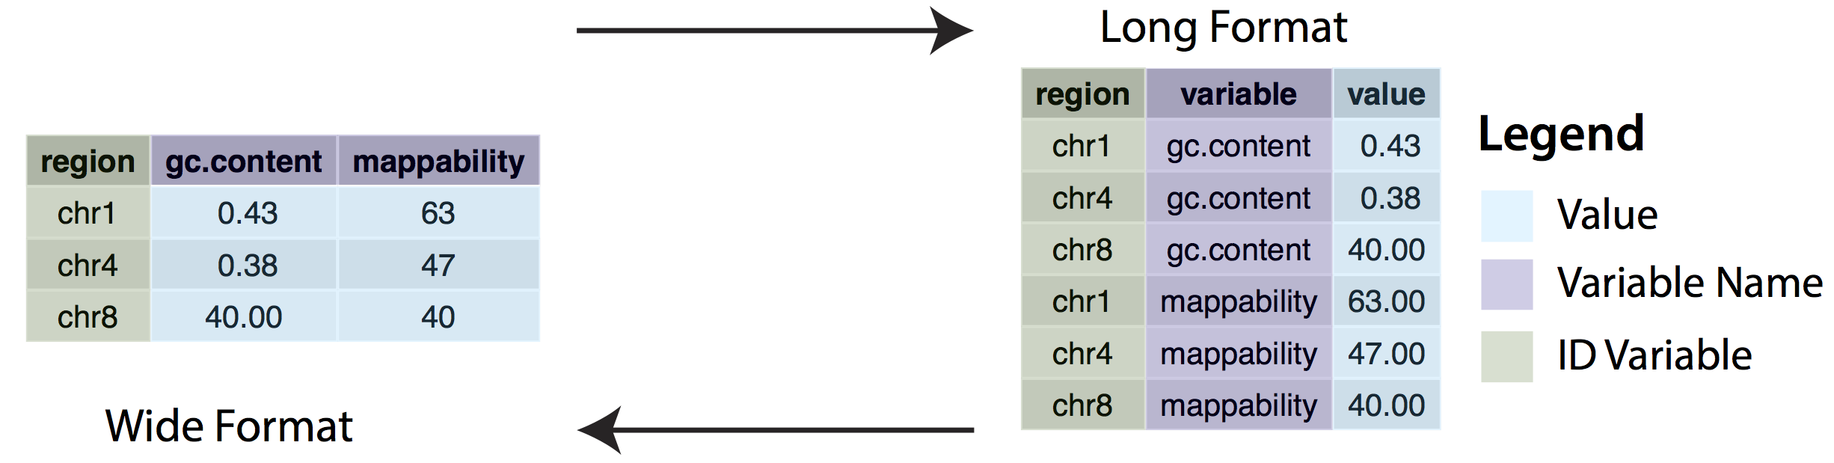
Reshaping data
gather(data=chrData, key = ”variable", value = "value", -region)
spread(data=chrData, variable, value)
To plot by groups we need our data to be in a long format!

Slide 18
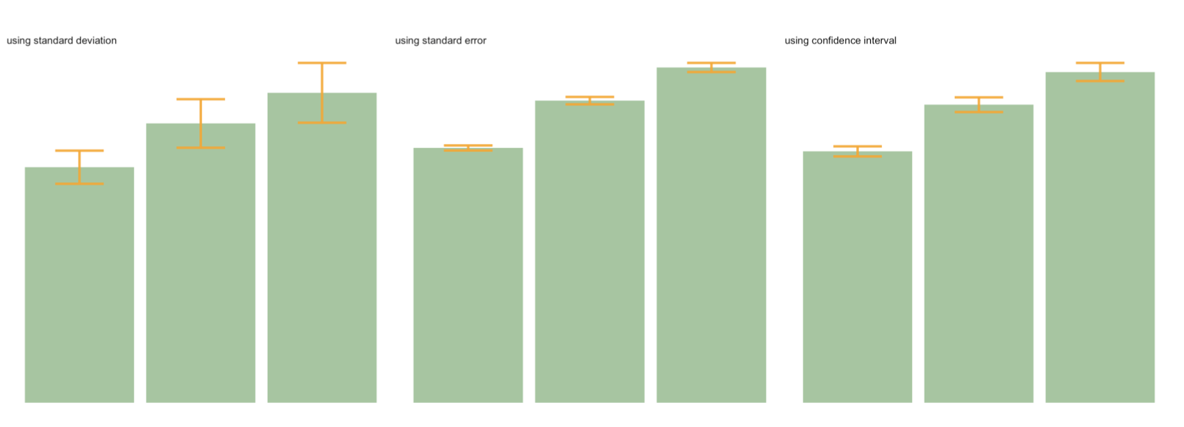
Error bars – geom_bar()
ggplot(data)
+ geom_bar( aes(x=group, y=mean), stat="identity", fill="forestgreen", alpha=0.5)
+ geom_errorbar( aes(x=group, ymin=mean-sd, ymax=mean+sd), width=0.4, colour="orange", alpha=0.9, size=1.5) + ggtitle("using standard deviation")

Slide 19
SD, SE, CI
Standard Deviation (SD) represents the amount of dispersion of the variable. Calculated as the root square of the variance:
sd <- sd(vec)
sd <- sqrt(var(vec))
Standard Error (SE) is the standard deviation of the vector sampling distribution. Calculated as the SD divided by the square root of the sample size.
se = sd(vec) / sqrt(length(vec))
Confidence Interval (CI).
This interval is defined so that there is a specified probability that a value lies within it. It is calculated as t * SE. Where t is the value of the Student's t-distribution for a specific alpha.
alpha=0.05
t=qt((1-alpha)/2 + .5, length(vec)-1) # tend to 1.96 if sample size is big enough
CI=t*se
Hint: easier way to add error bars without calculation! Explore stat_summary()

Slide 20
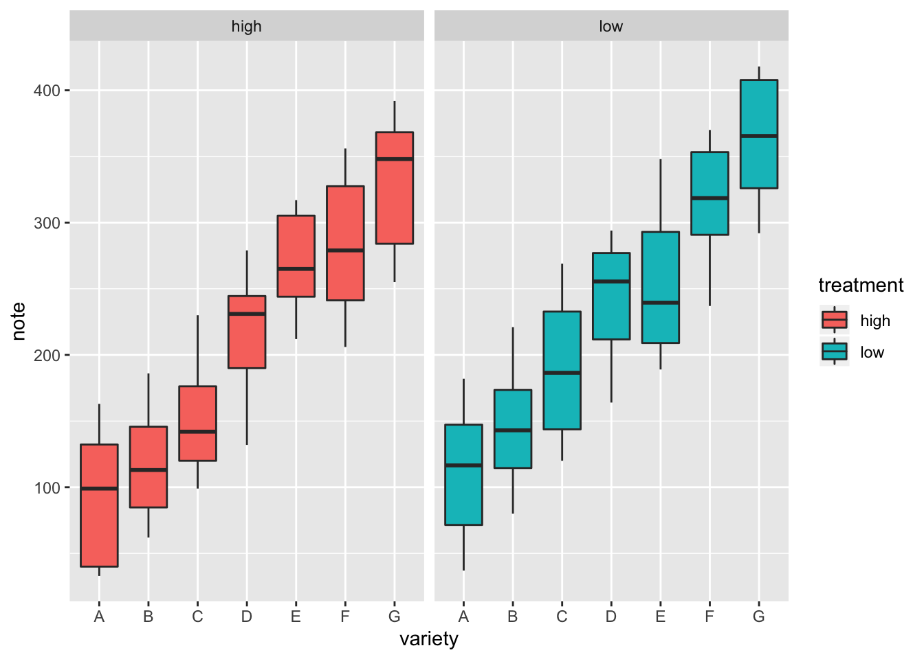
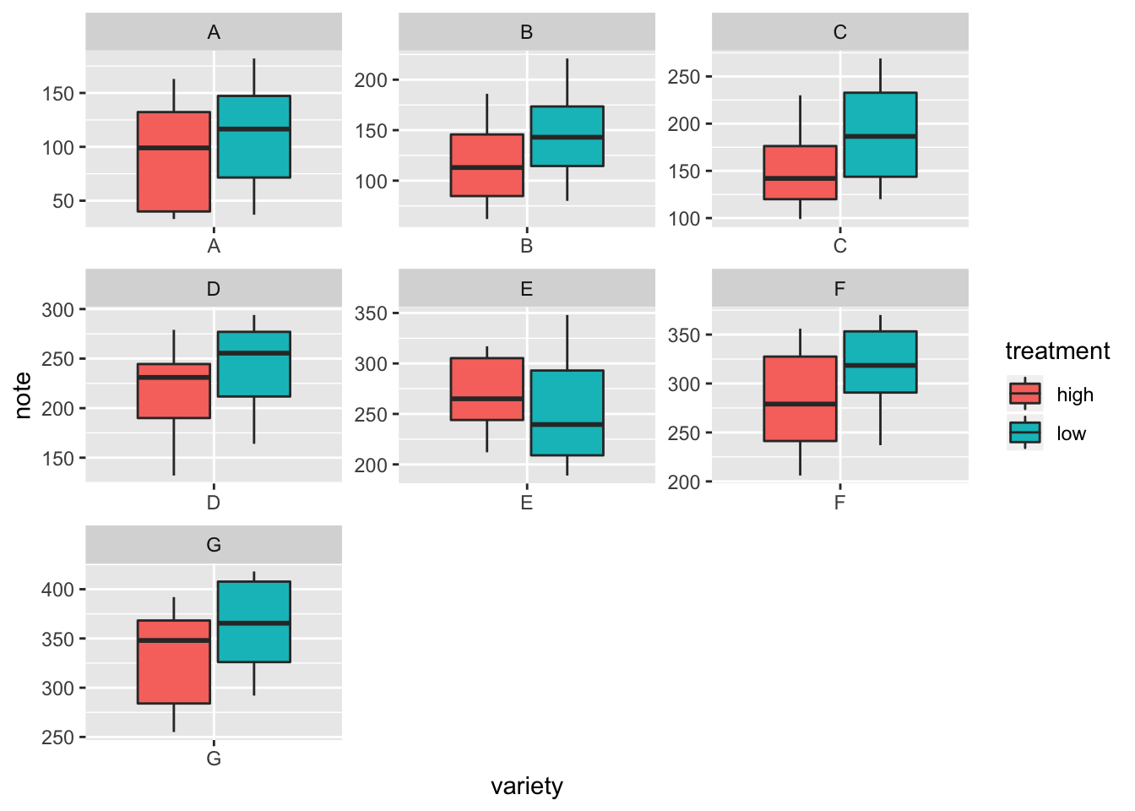
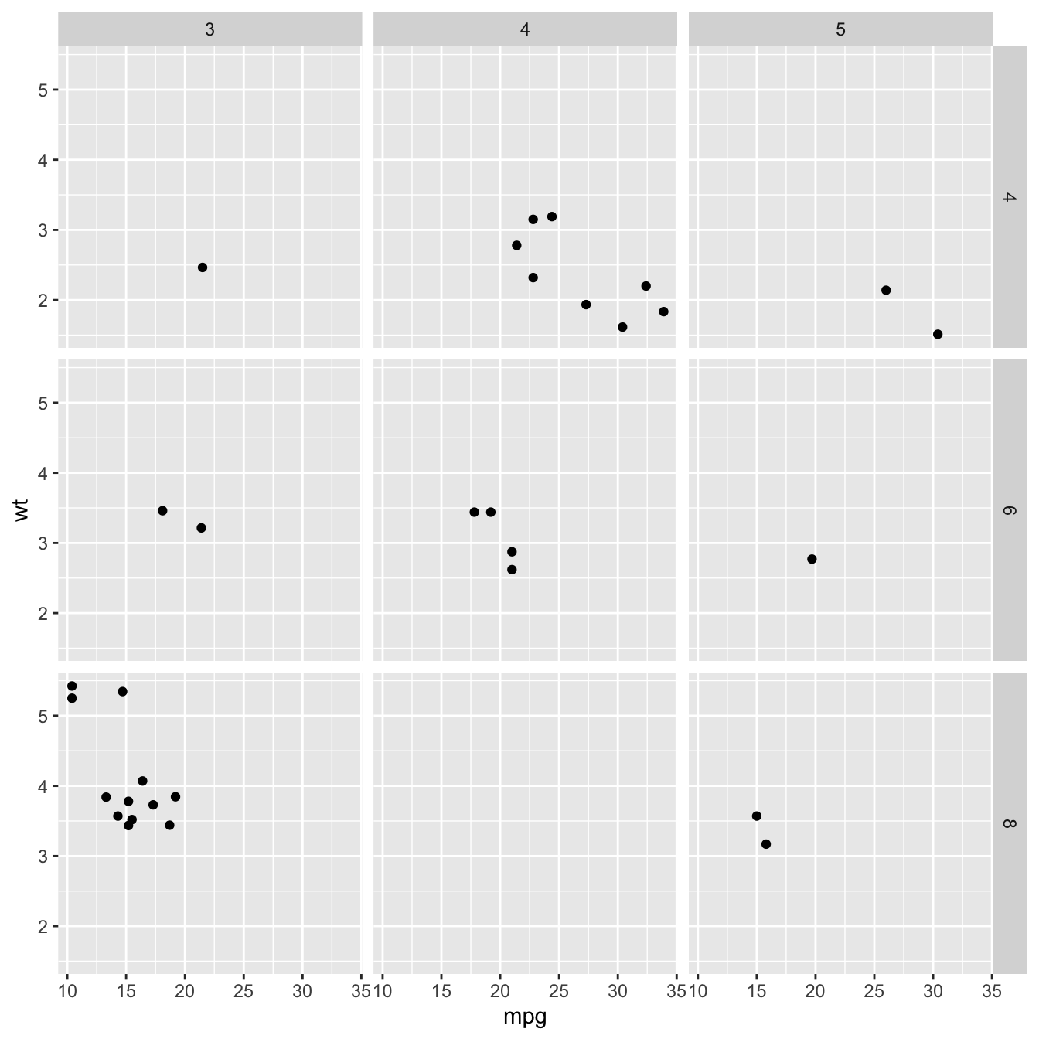
Faceting
facet_wrap(~var) builds a new chart for each level of a categorical variable
facet_grid(var1~var2) builds one chart for each combinations of 2 categorical variables

Slide 21
Let’s explore practically

Slide 22
Let’s explore practically
Address the tasks in breakout rooms!

Slide 23
Useful references
R Graph Gallery – Examples of the kinds of graphs and plots possible in R (+ the code to create them)
The Grammar of Graphics (Leland Wilkinson) – Theory of graphical visualisation (SpringerLink book – free access through Uni of Oxford Bodleian subscription)
ggplot2 reference – Help and cheatsheet
ggplot2 extensions – Additional packages that extend ggplot2 functionality
From Data to Viz – Decision tree to choose an appropriate chart type for your data

